Slide 1
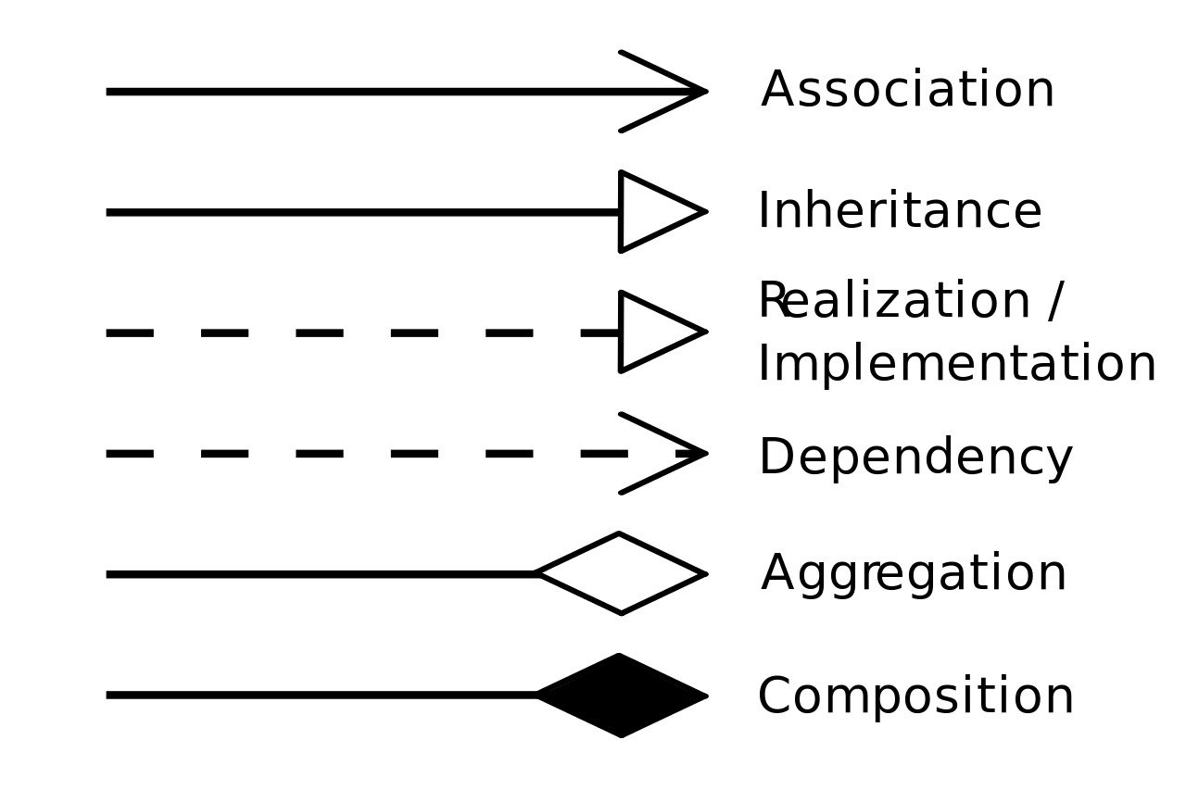

Class Diagram
Advertisement_user
User
Is an
id: UUID
full_name: String
address: String
Phone_No: Integer
EmailId: String
Authentication
AdverstismentID: UUID
Username (varchar)
Password (varchar)
created_at(date)
requests
Login As
Register()
editAccount()
getSummaryData() cancelUser() postUserCredentials() statusMessage()
Register()
Login() loginError()
Encryption() getSummaryData() generateUserData AndTokens()
SupportTicket
createAdvertisement()
modifyAdvertisement()
deleteAdvertisement()
generateStatistics()
generateClickCountOfAdvertisement()
setPrimaryAdvertisementTarget()
raiseQuery()
modifyQuery()
deleteQuery()
TicketIdID (uuid) ConfirmationId (uuid) createTicket(Date) resolved(Boolean) resolvedDate(Date)
issueType(Date) issueSubject(String) issueDescription(String)
priority (int)
Is an
Is an
Employee
dept_id: UUID
Works for
FinanceTeamUser
createTicket(formData)
sendConfimationId()
role: String
assignDepartment()
Works for
Business_user
seeRevenue()
modifyUserSubscription()
generateRefunds()
generateDiscountedPlans()
generateBilling()
BusinessID: UUID
Business
Id (uuid)
Name (varchar)
contact_no(varchar)
Address (varchar)
Works for
Works for
Works for
Advertisers
ID (uuid)
AdvertisementName (varchar)
AvertisementEmail (varchar)
AdvertisementPhoneNo (varchar)
AvertisementAddress (varchar)
CustomerSupportUser
trackOccupancy()
getOverparkingNotification()
accessCameraFootage()
generateMultipleFeed()
readLicensePlate()
raiseQuery()
modifyQuery()
deleteQuery()
TechnicalSupportUser
role: String
role: String
subscribe()
endSubscription()
generateTickets()
modifyTickets()
deleteTickets()
resolveTickets()
setTicketPriority()
getFeedback()
rateCustomer()
subscribe()
endSubscription()
accessCustomerCamera()
accessCustomerAccount()
modifyTicker()
resolveTicket()

